Slide 1

Concepts & Environment Set-ups
Make sure that your laptop can run basic Python3 programs. (e.g. Hello World)
If you haven’t installed Python, please proceed to install PyCharm.
https://www.youtube.com/watch?v=cHa85et7LK0
The installation instruction starts from 2:40.

Slide 2

Image Classification workshop
By

Slide 3
Let’s Start
1. Image Classification (IC) Concepts & Environment Set-ups
2. Image formatting & processing
3. Model Built-up & Model Training
4. Make predictions with the Model
Outline

Slide 4
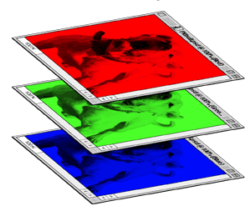
Concepts & Environment Set-ups
How do Computers achieve Image Classification?
When a computer takes an image as input, it will see an array of pixel values.
Depending on the resolution and size of the image, it will see a WIDTH x HEIGHT x 3 array of numbers. For example, suppose we have a colorful image with a size 480 x 480. The array seen by the computer will be 480 x 480 x 3.
The computer will then output the probability of the image being a certain class based on the manipulation of the array.

Slide 5

Concepts & Environment Set-ups
How is it relevant to Python?
Keras with TensorFlow is a high-level library set in Python to build and train Neural Networks.
1. User friendly 2. Modular and composable 3. Easy to extend
4. Developed by Google – High Quality!
Easy to start with 0 basic knowledges!

Slide 6
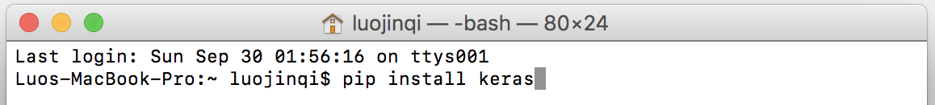
Concepts & Environment Set-ups
The operation is the same in Windows Command Window & MacOS Terminal:
pip install numpy
pip install scipy
pip install tensorflow
pip install keras
Please also do these after pip install:
pip3 install keras
pip3 install tensorflow
That will install the libraries on your Python3 environment.

Slide 7
Concepts & Environment Set-ups
Download the zipped pack from link:
That contains all the materials that we need today. (Slides also included)
Run test_environment.py to check whether your libraries have been installed.
Wait a few seconds to see the output of
Ignore the Warning Notes which programmers never regard.
If the message “Congrats” is shown, the your environment is ready to go.
Inform the speaker if any bugs happen.

Slide 8
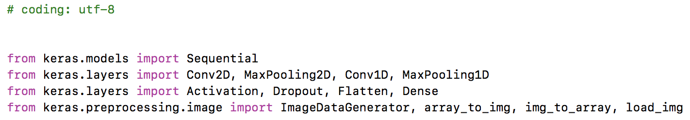
Concepts & Environment Set-ups
Type the following lines of codes to set up your coding environment.
(Or just copy the corresponding part from sample_model.py)
Now you are ready to process the images and train the model.
Before we leap: We have to know that the model training is actually calculating the parameters which will help the model make correct decisions.

Slide 9
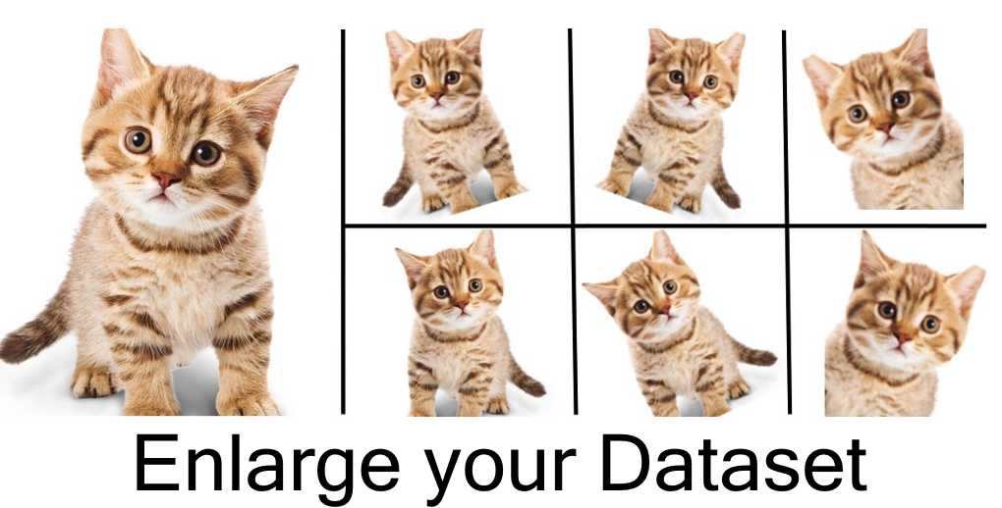
Image formatting & processing
Approaches that alter the training data in ways that change the array representation while keeping the object (label) the same are known as data augmentation.
It allows us to artificially expand our dataset. Some popular augmentations are horizontal flips, random crops, translations, rotations, and so on.

Slide 10
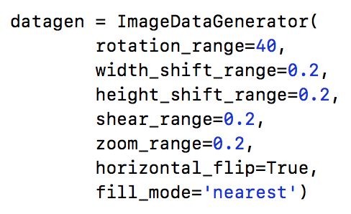
Image formatting & processing
Here we implement a generator from Keras.
(Type or copy the ImageDataGenerator from sample_model.py)
rotation_range: Degree range for random rotations
width_shift_range: Fraction range of total width for shifting.
height_shift_range: Fraction range of total height for shifting.
share_range
zoom_range: Fraction range for random zoom.
horizontal_flip: Randomly flip inputs horizontally.
fill_mode
If you cannot remember so much terms, don’t worry as this not the key things in IC.

Slide 11
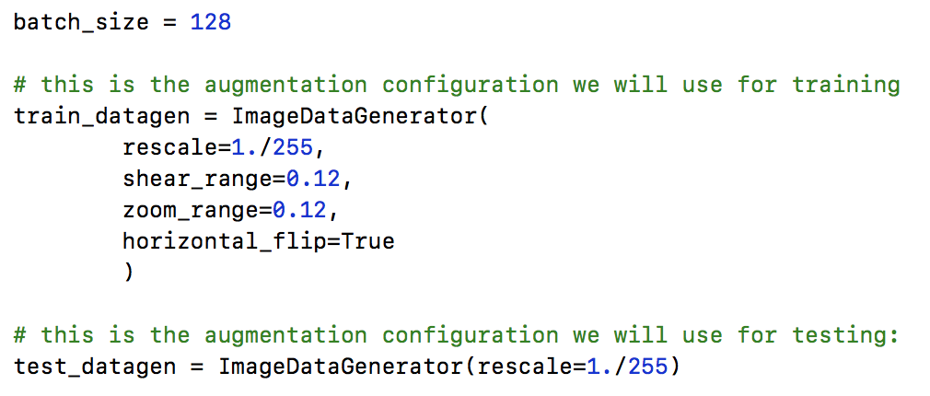
Image formatting & processing
Then we set up the generator for training sets and validation sets.
(Type or copy the generator from sample_model.py)

Slide 12
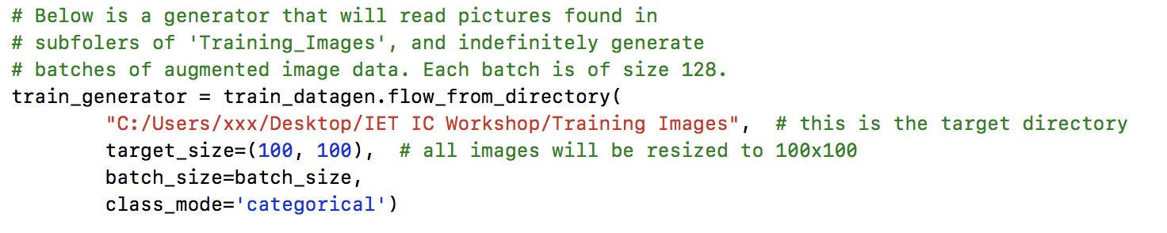
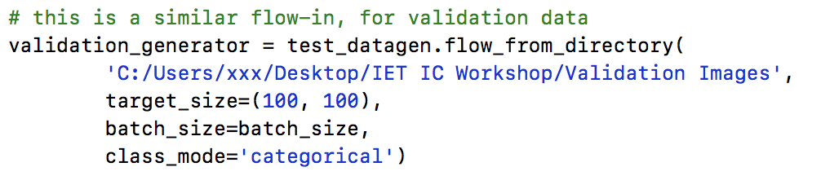
Image formatting & processing
The training and validation images are ready to flow in the program!
(Type or copy the code from sample_model.py)

Slide 13
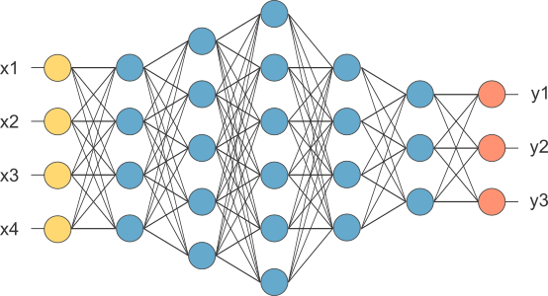
Model Built-up & Model Training
Neural Networks Models are basically
the combination of different Math Manipulations & Activation Functions.
Data flow in
Predication Output
Activiation functions
Hidden Layers (Intermediate Results) (in Blue)

Slide 14
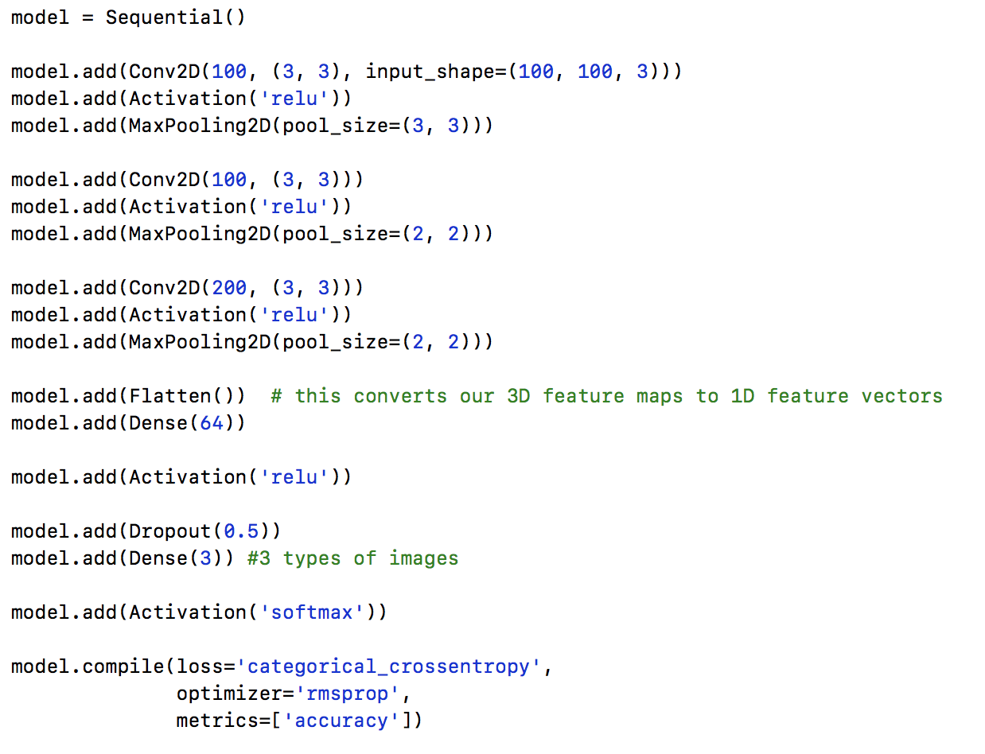
Model Built-up & Model Training
Here we implement a naïve neural network by hand.
This is the whole view
of the neural network.
Details of each part will be explained in the following slides.

Slide 15
Model Built-up & Model Training
Here we implement a naïve neural network by hand.
Sequential():
The function Sequential() is providing an “empty box” for the further implementation.
In other words, it is used to initialize the neural network model so that later we can add layers to this model.

Slide 16
Model Built-up & Model Training
Here we implement a naïve neural network by hand.
Simple Analogy of
Neural Network Layers
(For our model,
there is only 2 hidden layer)

Slide 17
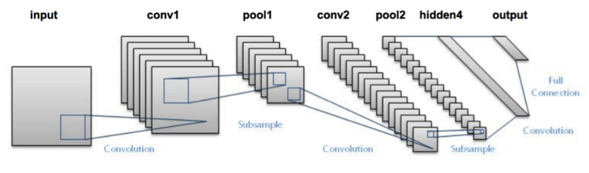
Model Built-up & Model Training
Here we implement a naïve neural network by hand.
Conv2D:
The convolution is usually the first step of a Convolutional Neural Network (CNN) on the training images. Each of the convolutions can be imagined as a flashlight that is shedding light upon and sliding over the image.
The flashlight in this layer is looking for specific features. If they find the features they are looking for, they produce a high activation. Since we are working on images which are 2D arrays we’re using Conv2D.

Slide 18
How Conv2D works

Slide 19
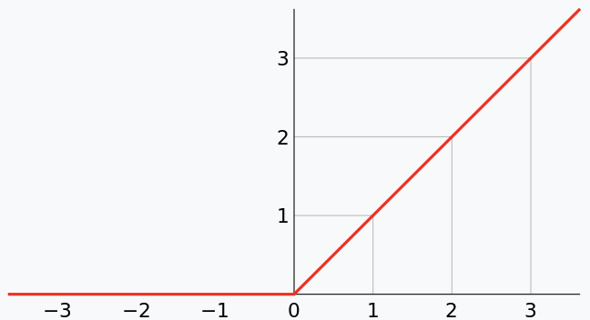

Model Built-up & Model Training
Here we implement a naïve neural network by hand.
ReLU:
Rectified Linear Unit (ReLU) is a kind of widely-used activation functions in CNN.
It finds wide applications in the area of Computer Vision and Speech Recognition.
“f(X) = X for any non-negative X”

Slide 20
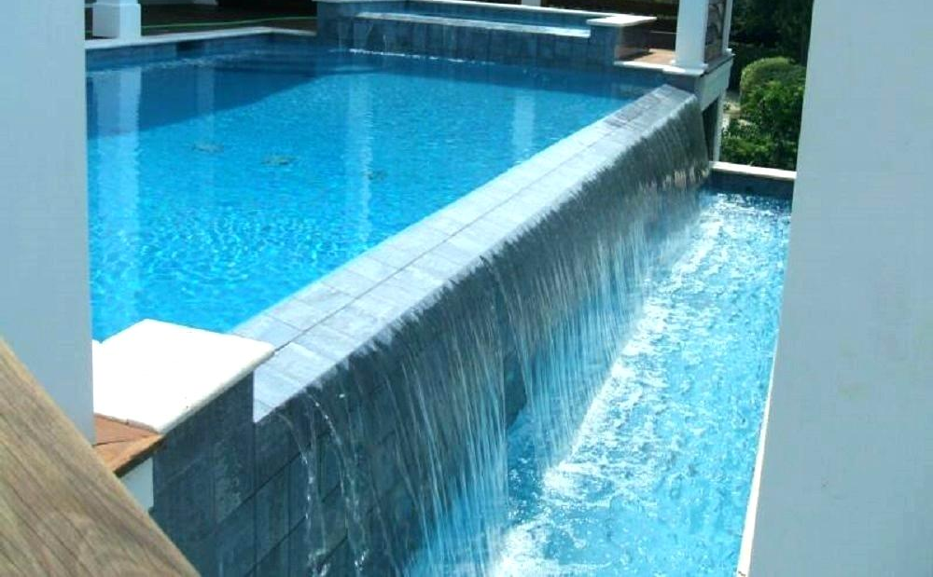
Model Built-up & Model Training
Here we implement a naïve neural network by hand.
MaxPooling2D:
MaxPooling2D is used for pooling operation. Pooling is mostly used immediately after the convolution to reduce the overwhelming data size (only width and height).
This reduces the number of parameters, hence reducing the computation and increasing efficiency.

Slide 21
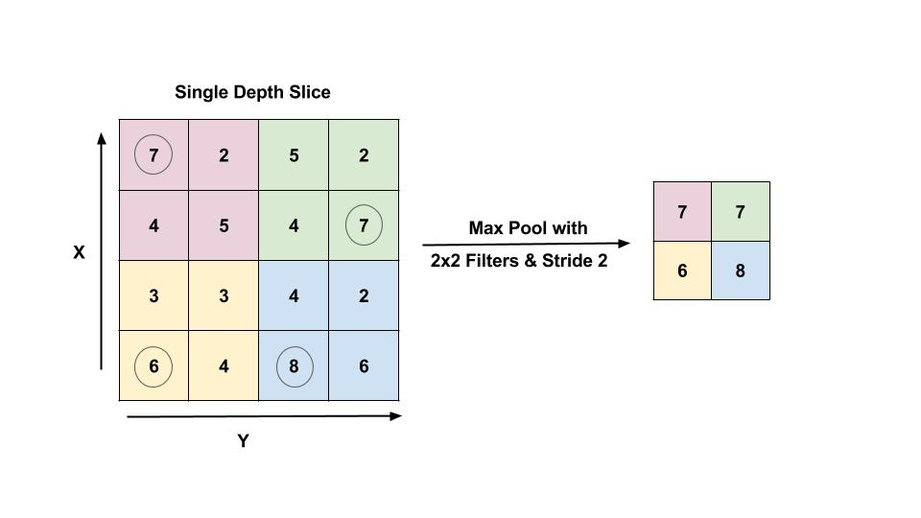
How MaxPooling2D works

Slide 22
Model Built-up & Model Training
Here we implement a naïve neural network by hand.
Flatten: Flattening is the process of converting all 3-D arrays into a single long continuous linear vector.
Dense: We also import Dense to perform the full connection of the neural network. A dense layer is a regular layer of neurons in a neural network. Each neuron receives input from all the neurons in the previous layer, thus densely connected.

Slide 23
Densely Connected

Slide 24
Model Built-up & Model Training
Here we implement a naïve neural network by hand.
Flatten: Flattening is the process of converting all 3-D arrays into a single long continuous linear vector.
Dense: We also import Dense to perform the full connection of the neural network. A dense layer is a regular layer of neurons in a neural network. Each neuron receives input from all the neurons in the previous layer, thus densely connected.

Slide 25
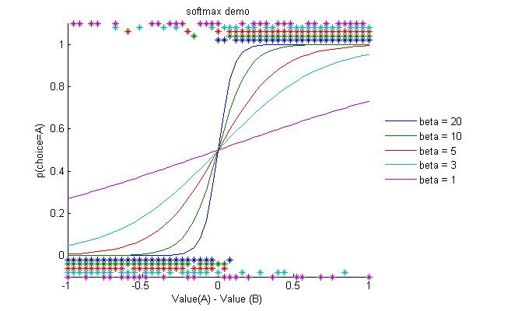
Model Built-up & Model Training
Here we implement a naïve neural network by hand.
Softmax:
The smooth function that ranges in (0,1). It converges input X into a correspondingly-large value in (0,1)

Slide 26
Model Built-up & Model Training
Here we implement a naïve neural network by hand.
Lastly, the model.compile gather up all the settings above and packed up the model for further training.

Slide 27
Model Built-up & Model Training
Here we implement a naïve neural network by hand.
loss:
The function is to represent the difference between the actual output and the predicted output by machine. During our training of the model, we will attempt to minimize the value. binary_crossentropy is usually used for a binary problem.

Slide 28
Model Built-up & Model Training
Here we implement a naïve neural network by hand.
optimizer: The function is to update the internal parameters of a model in such a way that the loss function is minimized.
metrics: List of data. accuracy means the percentage of correct answers. Metric values are recorded at the end of each epoch on the training dataset. It represents how well the model works just like the GPA.

Slide 29
Model Built-up & Model Training
Here we implement a naïve neural network models by hand.
Up to now, we have briefly explained how the functions in the model works.
If you cannot memorize all the terms, don’t worry. Many engineers just use pre-implemented models proposed by CS research institutions (e.g. CMU, UC Berkeley, Tsinghua, NTU, NUS)

Slide 30
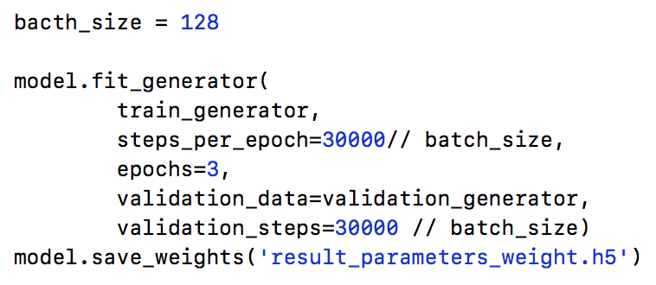
Model Built-up & Model Training
Last step: set the configuration to save the trained parameter of your model
validation data:
The data generator we have created previously for validation image data.
generator:
The data generator we have created previously for training image data.
epochs:
For each single epoch, the neural network is trained on every training samples to update its parameters.

Slide 31
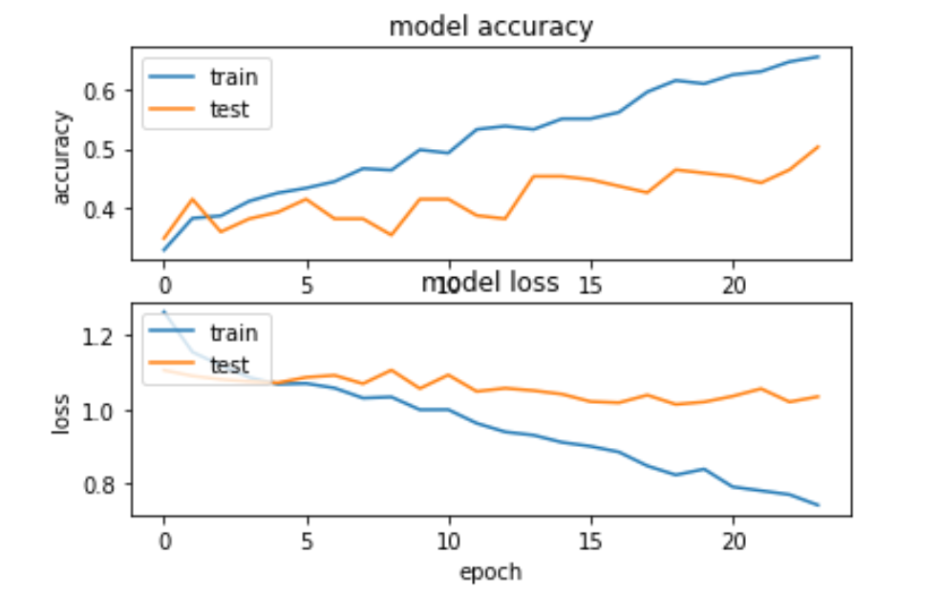
Model Built-up & Model Training
Run the whole file and wait until it terminates.
This may take a few minutes. Please inform the speaker if any bugs happen.

Slide 32
Make predictions with the Model
Now you have a result.h5 file which stores the parameter that you calculated.
You can begin using this result to classify Baby Hats, Pants & Shirts images.
Do remember to put your own pictures of jpg format in the your-own- images folder and edit the predict_with_trained_parameters.py with your own file path.
Run this py file to see the classification result of your images.

